Slide 1
Decentralized Model Training with a Tiered Peer-to-Peer Edge Network
CS-6220 : Big Data Systems & Analytics Project
Group 11
Saket Singh Niraj Srimal Raj Kothari Nimish Sule Berkay Barlas

Slide 2
Table of Contents
System Architecture and Functional Components.
Screenshots and Demos (This section contains all videos / experiments of our implementation).
Experiments
Advantages
Background

Slide 3
ARCHITECTURE

Slide 4
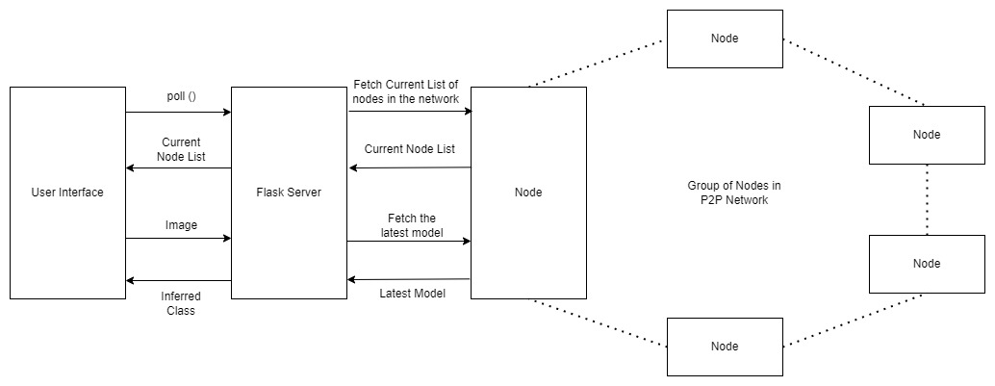
Functional Component – Interface Architecture
We developed an interface to interact with peers. It exposes 2 endpoints:
/node_list -> To return a peer’s perceived, arranged node list at any point in time.
/inference -> To carry out inference with the trained models.
The System Architecture for our User Interface is shown below:

Slide 5
Back-End Server
Flask Server:
This server runs on each node and acts as a medium between User Interface and nodes running in the P2P Network.
We have two main functions on the flask server:
Inference(): This function fetches the latest model currently deployed on the node and returns the inferred class for the given input image.
NodeList(): This function fetches and returns all the nodes present in the network. We then represent the multi-tier structure in the User Interface.
Node:
This node could be any node participating in the P2P network which communicates with the flask server to return current state of model / node list when requested by the user.

Slide 6
Functional Component - Interface
User Interface:
We have two main features in our User Interface:
Inference.
Tree Representation.
Inference: This feature is used to upload an image at two different time intervals and observe how the model’s accuracy is improving over time. It can be seen in the demo video that as time passes, the model learns to predict correct class of the input image and with more confidence.
Tree Representation: The Interface continuously polls the server running on a node in a P2P Network and fetches the latest structure of nodes present in the network. This structure is then displayed in the UI, and it can be observed how the structure changes as more nodes are added in the network.

Slide 7


Front-End Interface
Tech Stack: Angular and Angular Material
Page to run inference on any image: can take any image size from running device to send and receive updates
Page to provide current status of tier present in the P2P Network.

Slide 8
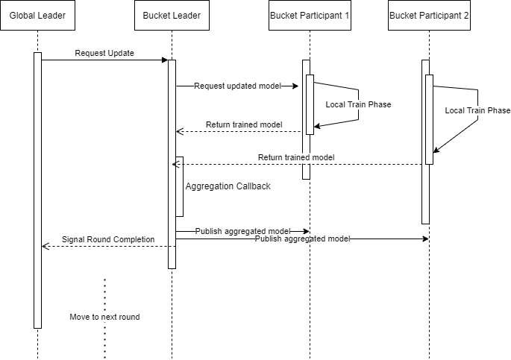
Functional Component – Tiered P2P State Machine
There’s a statically assigned global leader
It requests updates for a “round” periodically.
It waits for acknowledgement from the bucket leaders to finish aggregation, which in turn wait for their children before signaling completion.
Once global leader gets an acknowledgement from all other nodes, it proceeds to repeat the process for the next round.

Slide 9
P2P Architecture – Tiering Topology Implementation
Use linear arrays and self-indexing to establish tier-based tree topology.
Application-level gossip to distribute tree structure. Addition and removal nodes is notified to all participants
Each peer is aware of all the peers in the network and have a consistent view of the structure – i.e., their positions are statically determined each round. This static structure is an “arrangement”
Every node is part of the complete state machine, and its role is defined by the round it’s participating in.

Slide 10
P2P Architecture – Index-to-role Mapping in different tier levels
Each node derives its role using a linear list (the arrangement) which is guaranteed to be consistently arranged.
At each round r, and given a bucketing size b we perform the following computations to determine the role of a peer:
Is it a global leader?
If self index in the array is at position 0.
Is it a parent this round?
If self index in the array is at a position that’s a multiple of b^{r}
Must wait for children in the range to send their updates: [b^{r} + 1, b^{r+1}-1]
Is it a child this round?
If self index in the array is at a position p such that p%b^{r} != 0
Must send its weights to the nearest parent: int(p/b^{r}) * b^{r}
Here “r” is something that keeps going from 0 to log(n) (to base b), whereas b remains constant throughout the program’s run.

Slide 11
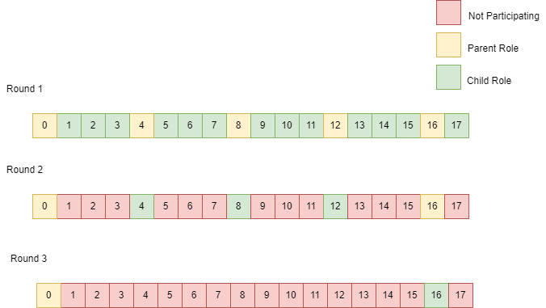
P2P Architecture – Tiering Topology Illustrated
Consider the following scenario with bucket size = 4, and number of peers = 18. The index-to-role mapping is done this way:
In round 1, all multiples of 4 (4¹) are parents, and multiples of 1 (4¹⁻⁰) are children
In round 2, the previous round’s parents become the children. Parents are indexed at multiples of 16 (4²), and children are multiples of 4²⁻¹.
This process repeats until there are no more children left to aggregate.

Slide 12
Functional Component - P2P Application Layer
INFORMATION COMMUNICATED
ADDITIONAL ACTION OP CODES
Hierarchy maintained with only single flat routing table in Kademlia
State maintained by communicating node list across peers
Node list contains hash ids maintained by Kademlia
Each Peer remembers the parent and child nodes for every round and messaging is done through the Kademlia routing using Node IDs.
Additional OP codes needed for topology maintenance on the application layer:
CLIENT EVICTED
SELF_UP
CLIENT_LIST_UPDATE

Slide 13
Functional Component - P2P Application Layer: Event Handlers
CLIENT SELF UP
CLIENT update
Initialize node list in a client.
Alerting the application layer of hash assigned to itself.
Handles receipt of updated weights from clients
Also handles receipt of aggregated weights from round parents.
CLIENT EVICT
REQUEST update
Remove from the node list
Required to enable application layer to readjust its topology copy.
An indicator of local weights being requested for a new round.
Round # information is used to determine participants.
Kickstarts the local model learning process.
CLIENT LIST update
Order the node list and decide the order
A mechanism to maintain topology consistency across nodes.

Slide 14
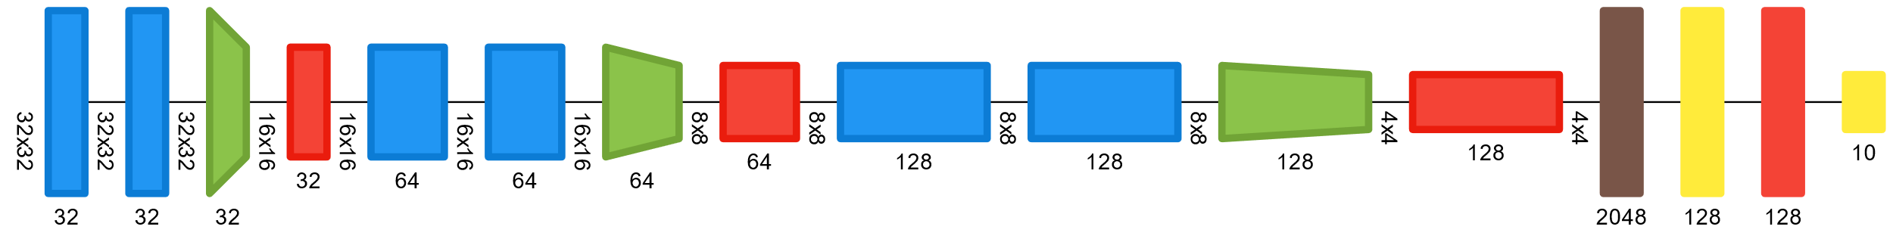
Functional Component - Model Architecture
The following model is replicated verbatim across all nodes.
Each peer trains its copy of the model with the data it contains.

Slide 15
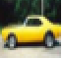
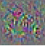
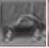

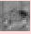
Layers used for model
2 convolutional layers of equal size helps us extract spatial and temporal features. Sample activation. Sample activations
Max Pool layers, were introduced for reduction, while increasing the number of filters used in convolutional layers
We keep architecture like the Federated Averaging benchmark (McMahan) with (32, 64, 64) to (32, 32, 64, 64, 128) since we are using added regularization due to the increase in the number of averaging done and better check the differences in accuracy for our experiments.

Slide 16
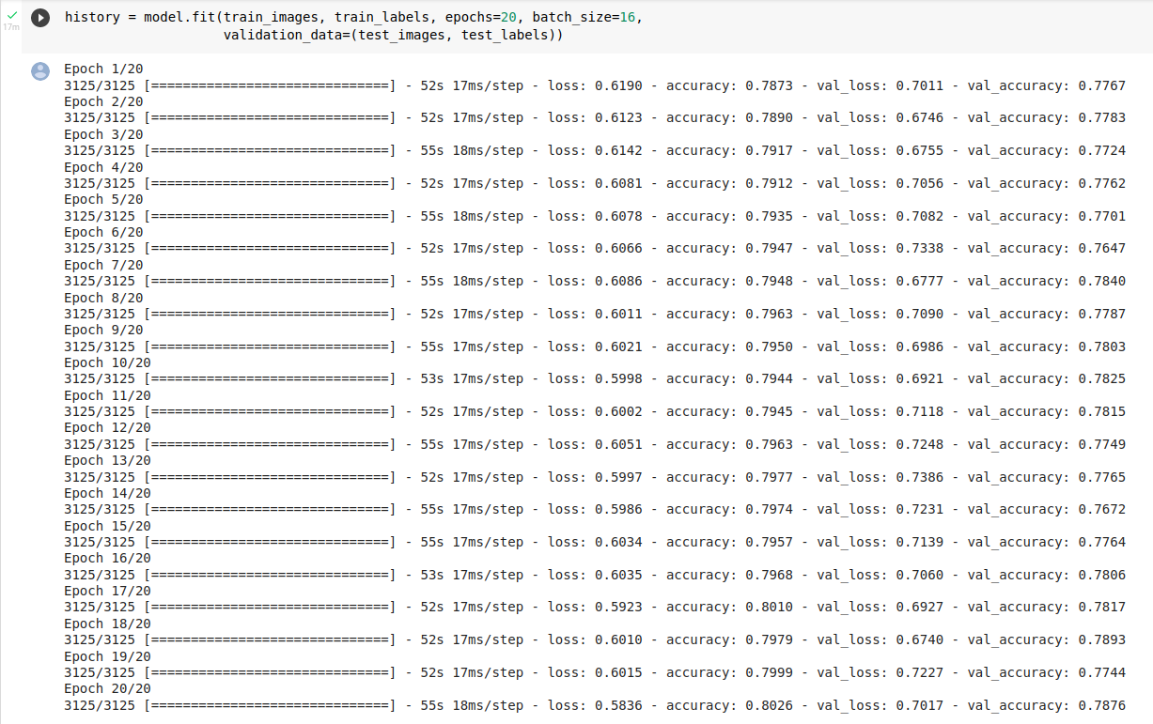
Functional Component – CIFAR Model - Accuracy on Entire Dataset
Model Accuracy on Entire Dataset of 60000 images = ~79% (Total Epochs = 40
CIFAR Model used for our P2P Application tested using the entire dataset with all 10 classes on Google Colab before being integrated into our Federated Learning Application which uses untrained models.

Slide 17
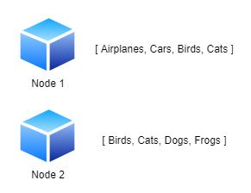
Functional Component – Machine Learning
For each model, we are choosing a random number of equal classes. For example, in one of the experiments, we are choosing random four classes for all nodes. However, since for each node, we are choosing classes at random, this enables nodes to have different four classes similar to real-world scenario.

Slide 18
Functional Component – Machine Learning
We are also storing some part of the dataset in each node as validation set. This set will be used to validate the accuracy of the model after each aggregation round is completed.
At any point in time, we will have a global version of model in the P2P multi-tier architecture and local version of model in each node.
After a leader at a particular level aggregates weights from its children and updates the model, that model is pushed to all of its children and their local model is updated with this global model.

Slide 19
Functional Component – Machine Learning
Similar number of classes chosen randomly – Each peer has the same number of classes which are selected at random, and the data is uniformly distributed across the classes.
Validation Set – We use a train, valid and test split of (0.6, 0.3, 0.1) of the amount of data available per node for each of our nodes, to evaluate performance of our model.
Global Model and Local Model – Global model at each peer which is the group leader at a particular round, responsible for accumulation of weights from other peers. Each node trains its local model once in the first round, and only aggregation of weights happen at the upper tiers.
Eventual Consistency of Models – The models across the P2P network become consistent after the end of one complete round (after completion of aggregation over all tiers)

Slide 20
Functional Component – Machine Learning
We are initializing all nodes with a sequential keras model from scratch to test how much a model learns through federated learning and multi-tier architecture.
We have tried various experiments to find the optimal hyperparameters suited for our model. They are as follows:
Optimizer: Adam
Learning Rate: 0.001
Beta1: 0.9
Beta2: 0.999
Loss: Sparse Categorical Cross Entropy
Since decentralized edge nodes are unlikely to have GPU access, tests were run on CPU
Federated Averaging used with parameters E=1, C=1, B=∞, that means, all samples were processed during one training round within a device, and all non-evicted devices were used for the averaging.

Slide 21
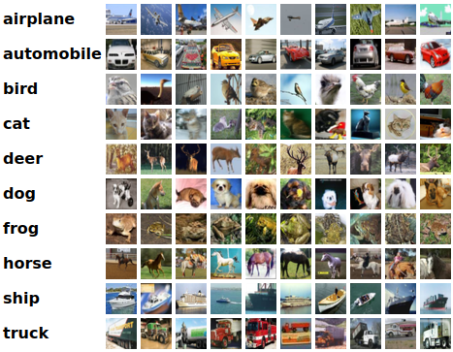
Functional Component - ML
For our implementation, we have used CIFAR – 10 dataset. The details of the dataset are as follows:
Number of Classes: 10
Number of Rows: 60,000.
There are 50000 training images and 10000 test images.
32x32 color images

Slide 22
Screenshots and Demos

Slide 23
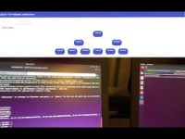
Tier based topology propagation – On Physical Machines
Here we ran 9 peer application processes across 3 different physical machines, each capable of running their own local training.
The peers were connected to the same WiFi network with an average latency of ~70ms.
Please find the video demo of the tiering tree propagation across the applications, with our real-time topology viewing interface.

Slide 24

Tier based topology propagation – On AWS machines
To test the scale of the system further, we ran 22 different machines running the p2p application code. In this experiment, we wanted to make sure that the system is deployment agnostic.
The peers were connected to each other with a high-speed network (ping latency of <1ms).
Please find the video demo of the tiering tree propagation across the 22 nodes, with our real-time topology viewing interface.

Slide 25
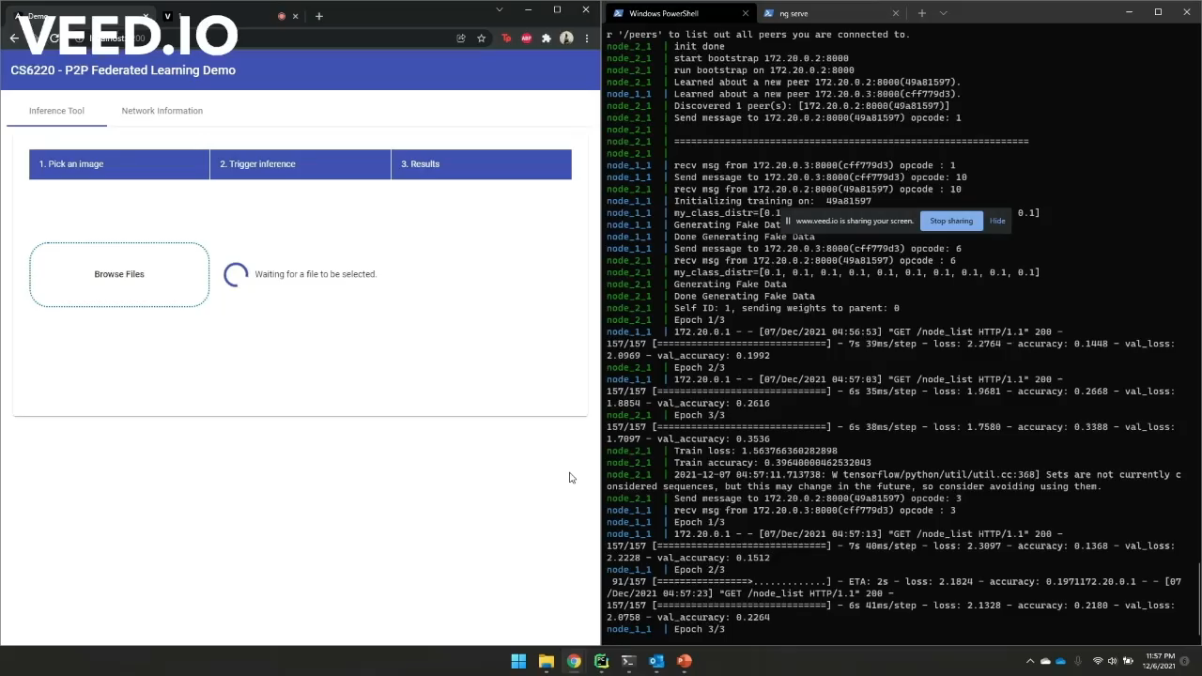
UI – Inference Example
Front-End Application Video – Inference Tool

Slide 26
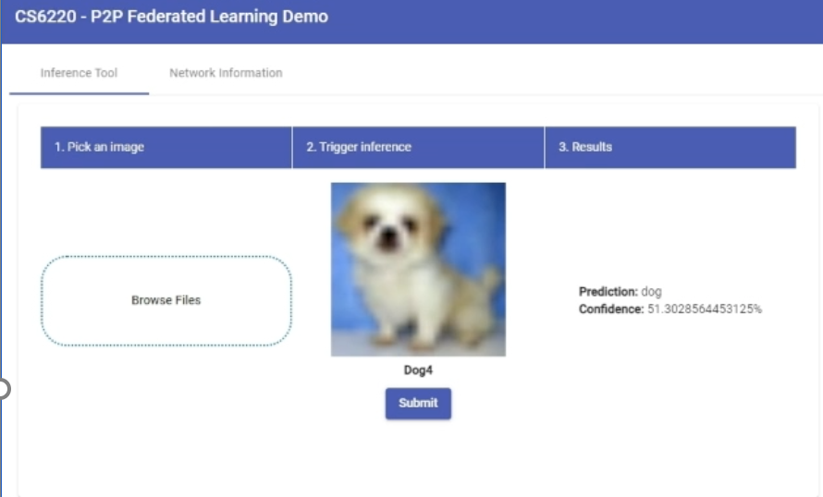
UI – Inference Example
Front-End Application

Slide 27
Experiments

Slide 28
Effect of number of peers in P2P system with heterogeneous devices
Parameters fixed:
Number of Classes = 6 (randomly selected for each peer and having uniform distribution)
Epochs = 20 over 5 aggregation rounds
Train Size = 20000 per peer
Tests with 6 and 9 nodes were run on 3 different laptops and for 17 nodes was run on AWS.
AWS instances had 87.34 microsecond network latency, while physical machines had 17 millisecond network latency.
The time taken for 17 nodes and 9 nodes on separate machines was roughly the same since all local training took place in parallel; T(aggregation) << T(local training).
Number of Peers | Node-wise validation accuracies | Average acc.
17 | 0.7413, 0.7337, 0.7634, 0.7298, …, 0.7656 | 74.67
9 | 0.7213, 0.7108, 0.7465, 0.7414, …, 0.7389 | 73.178
6 | 0.7183, 0.7721, 0.7397, 0.7225, 0.7172, 0.7351 | 73.42

Slide 29
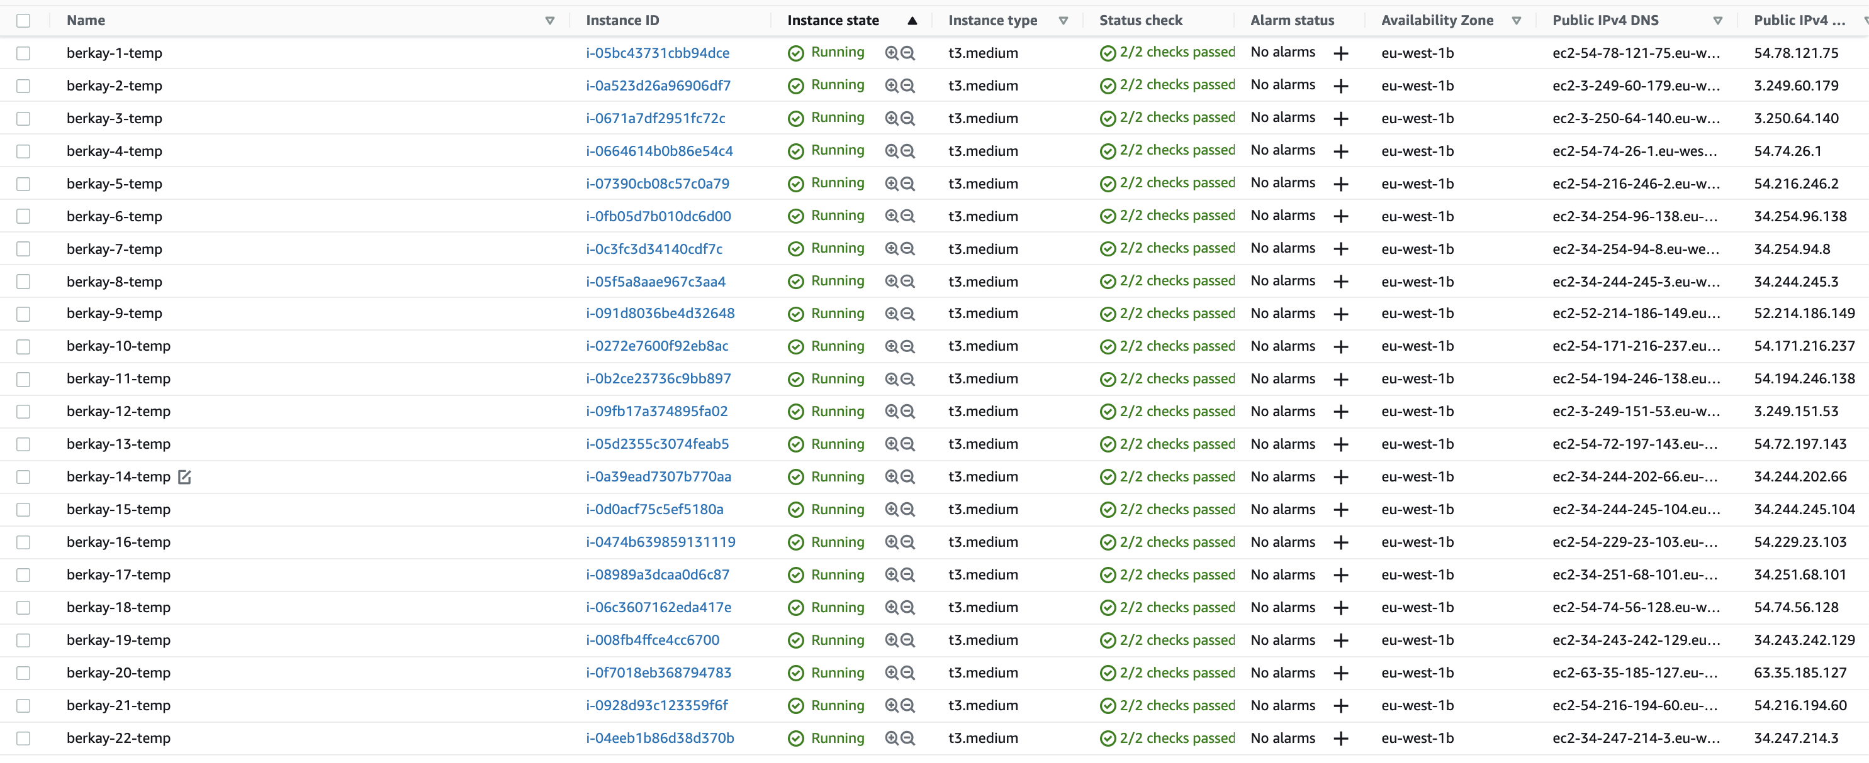
Experiment: Scalability Test
We tested the scalability of our system using 22 unique AWS instances/machines (2cpu and 4Gb each). We run only one peer application in each system.

Slide 30
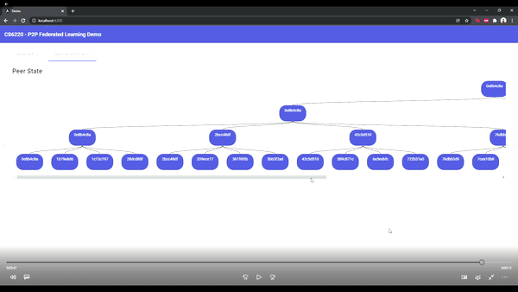
Scalability Test Analysis
As shown in the demo video before, we were able to recognize the 22 nodes and propagate the tree topology across peers.
We further ran training on 17 nodes, and the system was able to scale up, with the state machine executing as expected.

Slide 31
Experiment : 9 peers on 3 different laptops
Average Latency of Packets on the Wi-Fi Network:
~70 ms.
Network latency across all experiments was very small in comparison to the training time
No. Of Classes in each Peer: 6
Training Data Size in each Peer: 20000
No. Of Epochs: 20 per node over 5 Aggregation rounds
Validation Accuracy: 73.18%

Slide 32
Assumptions
For all our experiments, we set a common number of classes across all nodes and maintain uniform distribution. Example: Every node will work on exactly N classes (albeit randomly chosen) at a time.
We fix the size of dataset and partition dataset equally depending on the number of classes. For example: A dataset of size 10000 with N = 5 will split use 2000 instances of 5 classes chosen at random.
We expect no loss of messages currently for our state machine to progress.
We’re not aiming for the highest accuracy possible per node since we’re limiting our experiments by the number of epochs.
We start from a completely untrained model, as opposed to pre-trained models.

Slide 33
Comparison Metrics and Parameters
Since we’re running in virtualized environments, using raw time as a metric is not accurate. Our measure of time is total epochs of training. We compare results across configurations after running a set number of epochs.
Since we have multiple nodes, we’d want to consider mean validation accuracy and deviation across readings.
Configuration hyperparameters across tests:
Dataset size: To measure performance against amount of data present with clients.
Number of peers: To assess performance against amount of knowledge available in vicinity.
Classes per peer: To assess performance against knowledge of a wider availability of classes.

Slide 34
Effect of class distribution across peers
Parameters fixed: (Below table mentions the top 6 nodes accuracy from all nodes)
Num Peers = 17
Epochs = 20 over 5 aggregations
Training Data Size = 20000 per peer
# Classes | Node 1 acc. | Node 2 acc. | Node 3 acc. | Node 4 acc. | Node 5 acc. | Node 6 acc. | Average acc.
4 | 60.72 | 59.08 | 59.02 | 58.64 | 58.48 | 57.92 | 58.98
6 | 74.13 | 73.37 | 76.34 | 72.98 | 76.56 | 74.66 | 74.67
8 | 79.24 | 79.10 | 78.51 | 78.32 | 77.69 | 77.02 | 78.31
10 | 82.62 | 82.17 | 81.95 | 81.13 | 80.51 | 80.18 | 81.43

Slide 35
Result Inference –Trend for Class Distribution
An increased breadth of class information amongst peers is critical for seeing better overall performance.
We see that our network sees a huge boost when all nodes have a higher number of classes they’re aware of.
This is expected since the chance of overlapping known classes with parameter value = 4 is reduced by a lot.
This is only happening because we kept the number of epochs constant. This results shows us the number of epoch should be increased if the data is distributed nonuniformly.

Slide 36
Trend for Effect of data volume on Peers
Parameters fixed: (Below table mentions the top 6 nodes’ accuracy from all nodes)
Num Peers = 17
Epochs = 20 over 5 aggregations
Num Classes = 6
Data Vol. per peer (Train Size) | Node 1 acc. | Node 2 acc. | Node 3 acc. | Node 4 acc. | Node 5 acc. | Node 6 acc. | Avg. acc.
30000 | 78.98 | 76.45 | 76.25 | 76.10 | 74.03 | 73.65 | 75.69
20000 | 76.56 | 76.34 | 74.66 | 74.13 | 73.37 | 72.98 | 74.67
10000 | 69.33 | 69.20 | 68.45 | 68.75 | 67.68 | 66.78 | 68.36
5000 | 67.56 | 65.14 | 63.28 | 62.65 | 61.58 | 61.40 | 63.78
2500 | 64.75 | 60.45 | 55.96 | 53.58 | 52.95 | 51.44 | 56.54

Slide 37
Result Inference – Data Volume
As expected, a higher amount of data present in the client leads to quicker convergence.
Per epoch improvement is higher due to the data quantity.
The difference in accuracies after the same no. of epochs does not increase linearly with the size of dataset.
Over time, we’ll see that the difference grows larger before it plateaus.
There seems to be a lower amount of variance across peers when the amount of data increases.

Slide 38
ADVANTAGES

Slide 39
Advantages of our P2P System (Limitations of Centralized Federated Learning)
Eliminates Single Point of Failure
No Requirement of Central Trust
Low Computation Requirements
More Scalable

Slide 40
Why Tiering?
Limiting client load
Future use case: Cell Phones
Distributed power consumption across devices
Network bandwidth is highly limiting
Highly scalable
Clients’ ease of processing lower amounts of data
Tiers can vertically increase forming large but manageable trees
Slow global convergence, but quick local convergence
Effective geospatial separation
Learning moves with users
Local learning more relevant than global (think going across countries)

Slide 41
Why P2P?
Design inherently fault tolerant
Clients join/leave often
Round-wise participants are free to rotate
Minimal central server involvement
Central server can “prepare” clients and get out
Knowledge sharing between a small group of clients
Easy discovery and low configuration costs
Once part of the system, discovery handled by design

Slide 42
BACKGROUND

Slide 43
Introduction to Federated Learning
Machine learning technique that trains an algorithm across multiple edge devices or servers holding local data samples, without exchanging them.
Privacy-sensitive data.
Shared prediction model without sharing of data.
Medical Data, IoT, Siri’s Voice Recognition, Predictive Text, Emotion Recognition.

Slide 44
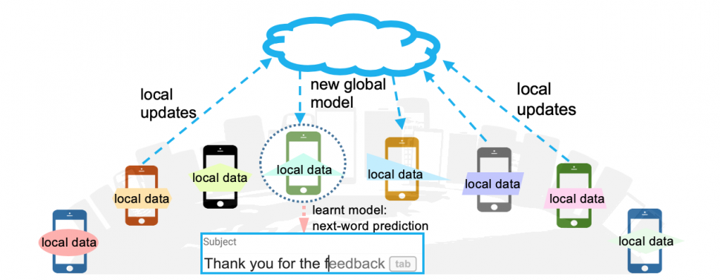
Centralized Federated Learning
Two models : Local and Global.
Local model (Edge Devices) : Trained with local data available at edge devices.
Global model (Central Server) : Local models weights averaging and retraining.

Slide 45
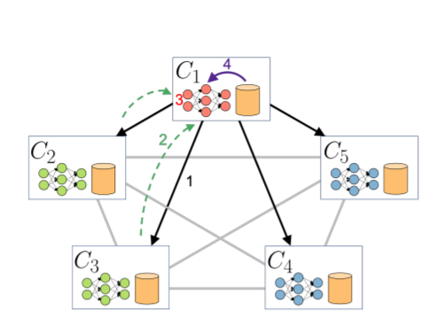
Decentralized Federated Learning
Decentralized Peer-to-Peer Federated Learning.
Eliminates dependance of central sever and central trust.
Fault-tolerant.
Peer-to-Peer.
ML Task - Image Classification.
Design can work for any ML algorithm.

Slide 46
Related Work
Centralized Federated Learning (McMahan et. al), 2016
CIFAR 10 Deep Neural Network Benchmarks
( 2013-)
Decentralized Learning Frameworks
(2020-)
Decentralized Federated Learning (ChainFL, Brain Torrent)(2019-)
Tree Based P2P (Hudzia) (2006)
Tree based P2P for heterogeneous clients
(Zheng, 2012)
Centralized Federated Learning Frameworks (Tensorflow Federated, 2019-)
Heterogeneous devices (Moshfit, 2021-)

Slide 47
Final Thoughts and Lessons Learned
Both data volume and knowledge of all classes are crucial for better results.
A higher number of peers did not seem to have a very positive effect, especially with increase in aggregation levels even though the overall chance of encountering all classes grows with the number of peers.
Aggregation techniques need to be tweaked for better results. The current technique ends up plateauing accuracy after a few weight sharing rounds.
Current Limitation/disadvantage of this design is that parent or children might be in more than one hop distance based on the routing table size causing the message to be relayed through multiple hops to the target. This however can be factored in future while making groups for better performance across the network and efficient low-latency communication amongst closely located nodes.

Slide 48
Future Work
Support for different, weighted averaging schemes.
Use alternate distributed tree creation algorithms to optimize for network bandwidth (E/R trees)
Improve fault tolerance on a sub round level
Implementation on Edge/Mobile Devices – requires reduction of memory usage.
Incorporating Heterogenous Devices for Dynamic Partitioning
Compute Power
Geospatial Locality
Network instability and latency
Using a higher resolution dataset with more classes Example – Face Detection on VGGface2 Dataset
Benchmark on multinomial classification dataset such as celebA

Slide 49
THANK YOU!

